Slide 1
Network Scanning/sniffing

Slide 2
Network has 4 pillars
Address
Logical
Physical
Protocols
Base (TCP & UDP)
Service (rest)
Network Type
E.g. Skada (like Stuxnet)
Volatile ( Infrared N/w)
Service Type/option
E.g. SMTP-multiple command

Slide 3
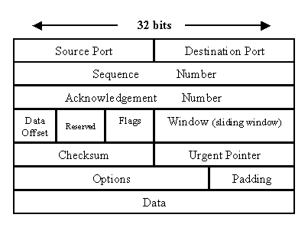
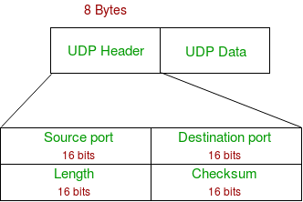
2 Protocols- TCP and UDP
TCP header UDP Header

Slide 4
Inclass Question
Q. Suppose Sender is sending packets to the receiver.
If suppose last 5 packets are lost?
How does receiver know how many packets are there?
What is the last packet?
Ans:
Therefore in TCP there is a index packet which sends total no. of packets before sending all the packets
And connection is not disconnected till sender does not receive acknowledgement for it.

Slide 5
Protocol Header
E.g. WhatsApp
It takes message on https (because end to end encryption)
For Messages it uses TCP
For voice it uses UDP

Slide 6
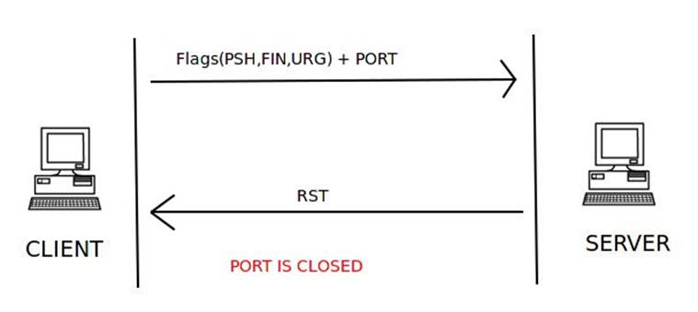
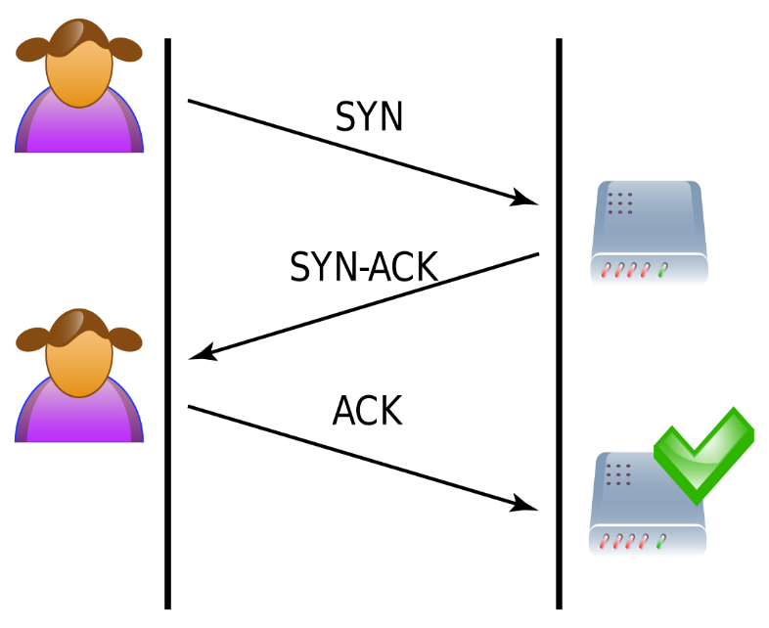
Flags
Syn: Synchronise Flag RST: Reset Flag FIN: Finish Flag
Ack: Acknowledgment Flag Forced Stop
3 way handshaking
https://cybersecuritynews.com/syn-attack/?fbclid=IwAR0CSGi3D-pb5LE1V1-cPVdIKeIhpZ5Lpm9qbATVjd7m6fQSMXELIaIoAXA

Slide 7

Network Scanning

Slide 8
Network Scanning
Another type of scanning
Scan network to extract information
Web link
Source IP
Destination IP
usernames
Passwords
Can be done by sniffing packets
If Using Same credentials for other sites like LinkedIn, Twitter, etc
Cookies

Slide 9
What is a Packet Sniffer
To monitor the data transmitted over a network
used for diagnostic or troubleshooting purposes
To steal data transmitted over the network.
Applicable to both wired and wireless networks
Can be passive or active

Slide 10
What information can be retrieved from a sniffer?
Examples
If an end user sends credit card information over an insecure protocol.
If the attacker manages to steal the private cryptographic key, then it can be directly provided to sniffer to decrypt all the communication.
Use of weak standards like WEP are vulnerable to sniffing.
?

Slide 11
Class Task
WEP
WAP
WAP2
??
WIFI at your home uses what?
Check and take screenshot with your admin name in it so to identify that it is your system only.

Slide 12
Top Sniffing Tools list
Wired and Wireless Tools
Tcpdump
Kismet
Ettercap
Dsniff
inSSIDer
Cain and Abel
inSSIDer
Cain and Abel
Caspa
Aircrack-ng
Wireshark

Slide 13
Wireshark
World’s foremost and widely-used network protocol analyzer.
Tells what’s happening on your network at a microscopic level
Standard across many commercial and non-profit enterprises, government agencies, and educational institutions.
got famous in black hat.
observes the messages exchanged.
Passive and Preinstalled in Kali Linux, for windows http://www.wireshark.org.

Slide 14
Wireshark-Steps
Open wireshark and click on interface list
Or click on capture > interfaces
Select one interface by clicking on checkbox and start
It will show all the traffic in the network
When you want to stop capturing the traffic, press red button on top
To view details of a packet, select the packet
Bottom panel will show you lots of information about the packets and protocols that were used

Slide 15
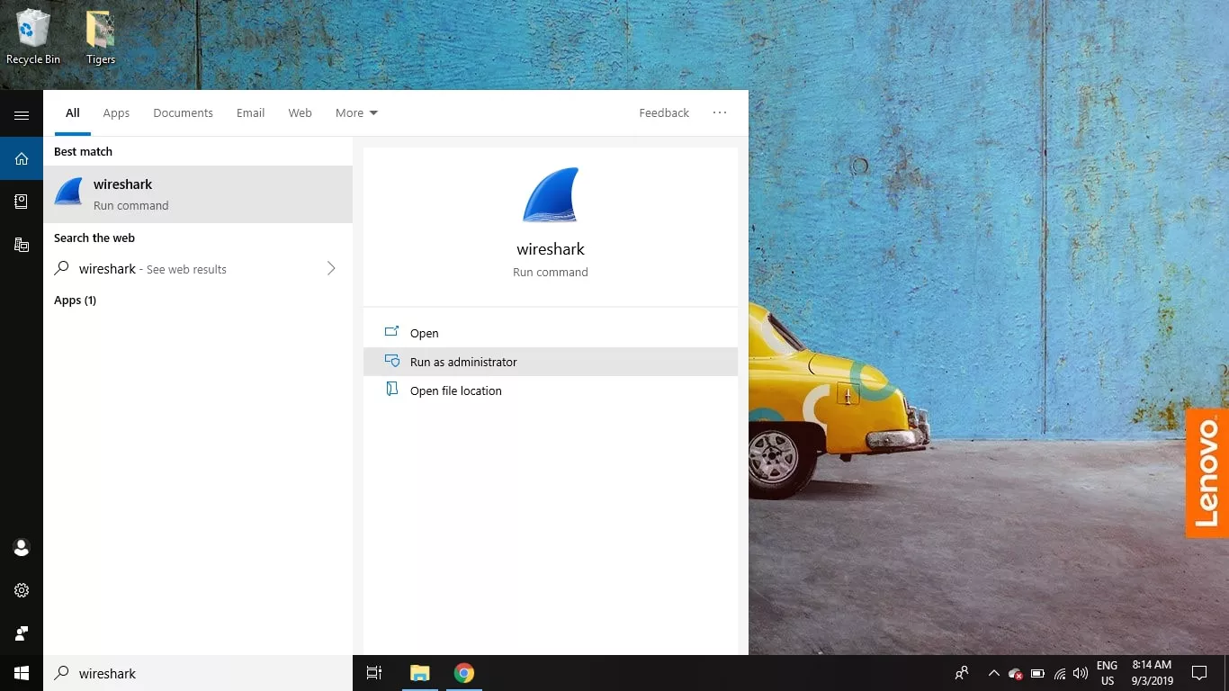
1. Open the Wireshark
Run as admin

Slide 16
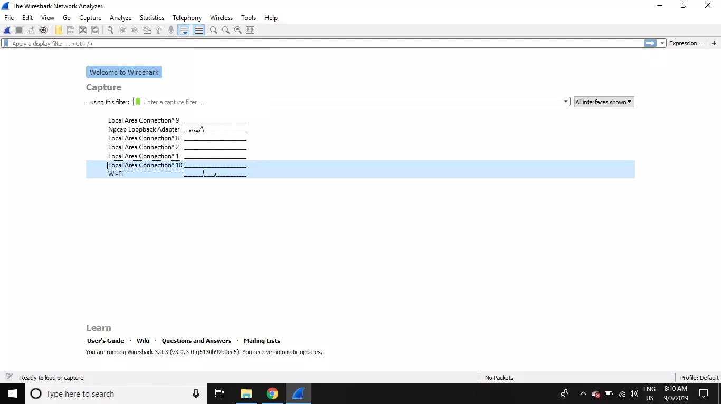
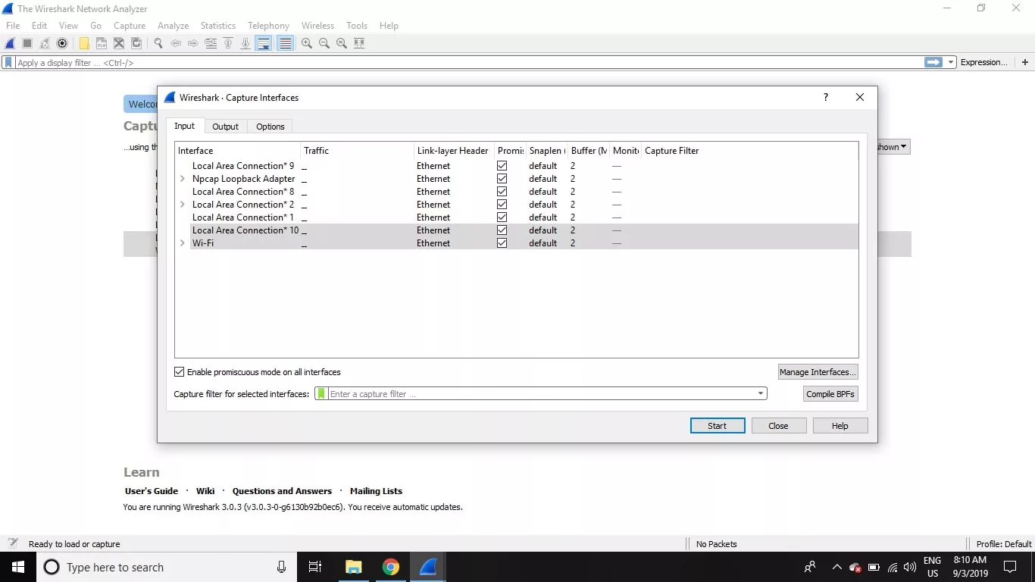
2. Select the network/interface
Select one or more of networks, go to the menu bar, then select Capture.
Promiscuous mode
On – record all packets reaching the interface
Off – record only those packets directed to the host.

Slide 17
4. Shows all the traffic
It will show all the traffic in the network

Slide 18
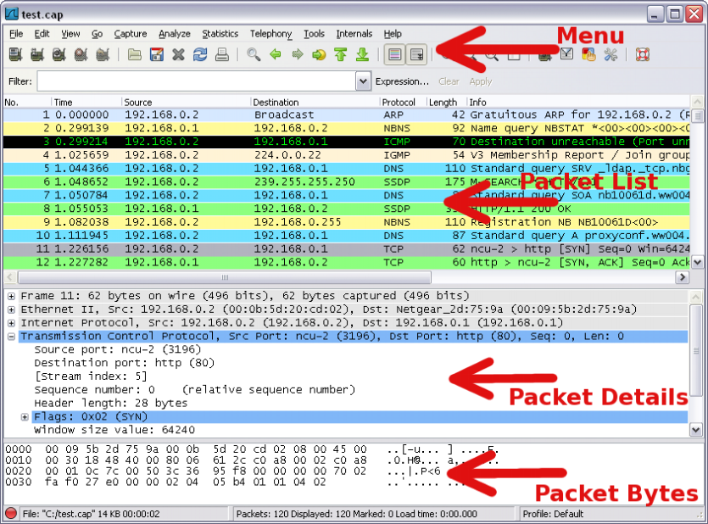
4. Shows all the traffic
It shows the traffic that has been captured can be analysed through
Packet List
Packet Details
Packet Bytes

Slide 19
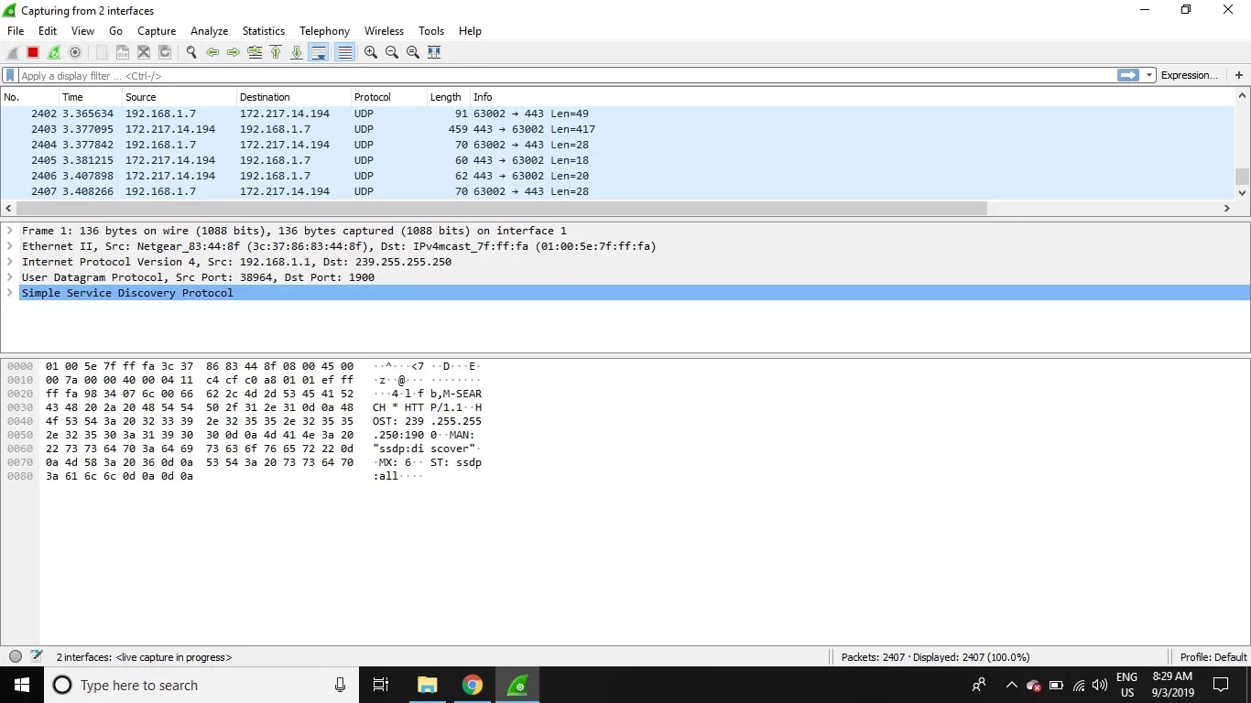
5. Stop Capturing
To stop capturing, press Ctrl+E. Or, go to the Wireshark toolbar and select the red Stop button that's located next to the shark fin.

Slide 20
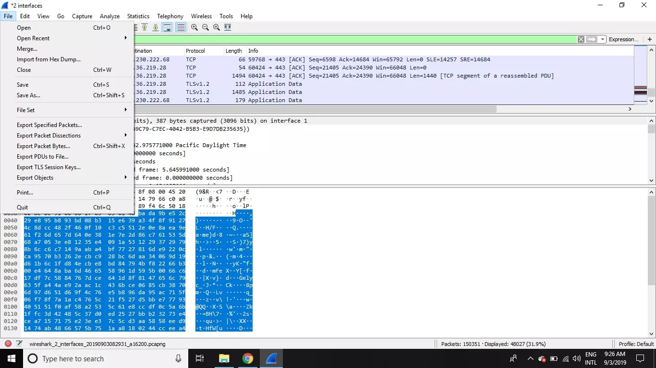
6. Save File
Select File > Save As or choose an Export option to record the capture

Slide 21
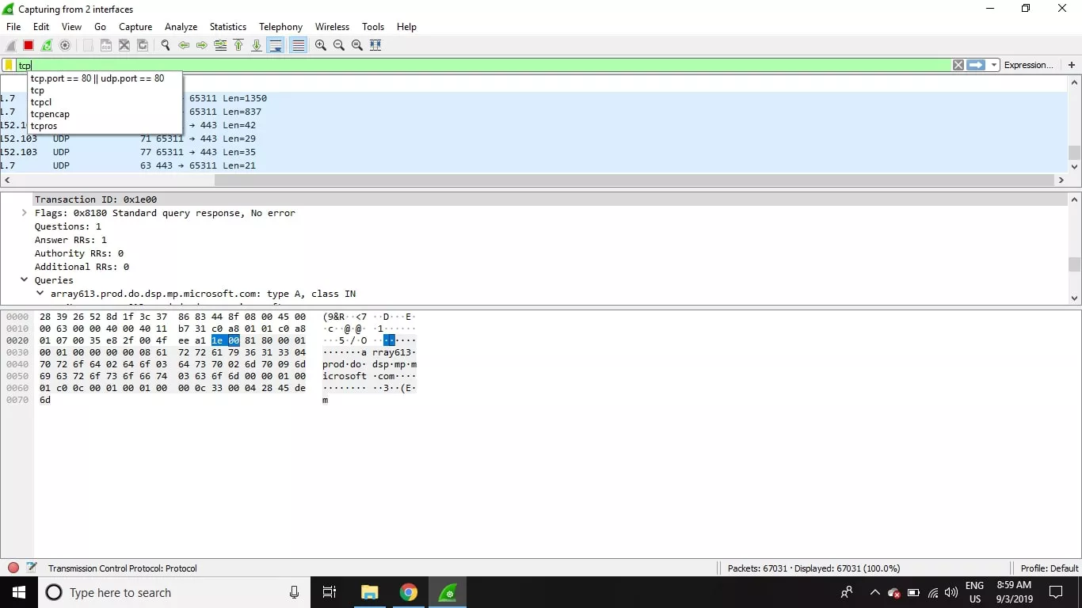
How to Use Wireshark Filters
Provides a predefined filters by default ( Apply a display filter)
If you want to display TCP packets, type tcp

Slide 22
How to Use Wireshark Filters
a. it can specify an address
e.g. host 192.168.0.1
host 10.1.11.24 and host 10.1.11.1
ip.addr==192.168.0.1
ip.src==10.1.11.0
b. it can also specify a protocol
e.g. tcp port http [for tcp protocol (tcp port on which http is running)]
tcp.port==80||tcp.port==3338
tcp.port==80&&tcp.port==3338
c. not broadcast nor multicast
capture unicast messages
e.g. Combine filters: the traffic from a particular IP and for http
HTTP && IP.src=12:234:56:67:67:12

Slide 23
In class Exercise
How to check malicious packet
?

Slide 24
To check victim’s using http-GET request
Start Wireshark to capture packets
Go to web browser, open some image
Stop capture in Wireshark
You will see an get line and then a HTTP1.1 get request line
This should be the HTTP GET message that was sent from your computer(ex. PC1) to the PC2 HTTP server.
And next http line shows response from web server (handshaking)

Slide 25
To check victim’s using http-Get Request
Select it, you will see a JPEG or PNG key depending on which format of image you have opened
Select and right click.
You will get the actual file which was opened by the Victim
Select option Export Selected Packet Bytes : Save file/ open
00Ref_Wireshark_webLink&userpass.docx

Slide 26
To Crack Password of victim’s using http-Post
Start Wireshark
Open a HTTP login website
Enter username and password credentials (e.g. game site, erp, LMS)
E.g. http://www.addictinggames.com/
Apply HTTP as filter and locate a POST packet
Right click and select Follow TCP Stream
Find username and password there
If insecure username & password are visible in plaintext form
If secure, username & password might be available in encrypted form
00Ref_Wireshark_webLink&userpass.docx

Slide 27
Exercise/Assignment
Q1. Perform the attack to find the websites(specific information e.g. cat) visited by the victim
Q2. Perform the password hijacking on http website (not secure website)
Find the username and password
Write steps with screenshots

Slide 28
Cookies
An HTTP cookie is also called web cookie, Internet cookie, browser cookie or simply cookie
Small piece of data sent from a website
Stored in the user's web browser while the user is browsing.
Remember info entered in form fields such as names, addresses, passwords, and credit card numbers.
E.g. Remember items added in the cart in an online store
E.g. Recording which pages were visited in the past.

Slide 29
Types of Cookies
Cookies
Session
Persistent
In temporary memory
Delete session cookies when browser closes
Expires automatically
expires at a specific date
Stores Cookies
Tracking cookies
Reset if the expiration time
user's web browsing habits
avoid re-entering login credentials

Slide 30
Use of Cookies
Uses
Session management
Personalization
Way for users to record items
However, the contents of shopping cart are stored in DB on server, rather than in cookie on the client
server sends a cookie to the client that contains a unique session identifier
Session identifier will be sent back to the server every time the user visits a new page on the website
Used to remember information about the user
Cookie containing the username last used to log to fill automatically the next time the user logs in

Slide 31
Q. Find IP address using Wireshark and tell them you know where they live?
In the filter bar, type UDP
You are set to troll people
Open omegle.com
Start chat by typing hey
Type ”wanna bet I can find where you live”
Start a new capture
Open ipaddress.com/search/
Type destination found above (2.88.12.41) & press lookup
This provides destination country e.g. “Saudi Arabia”, Administrative contact & other details

